Slide 1
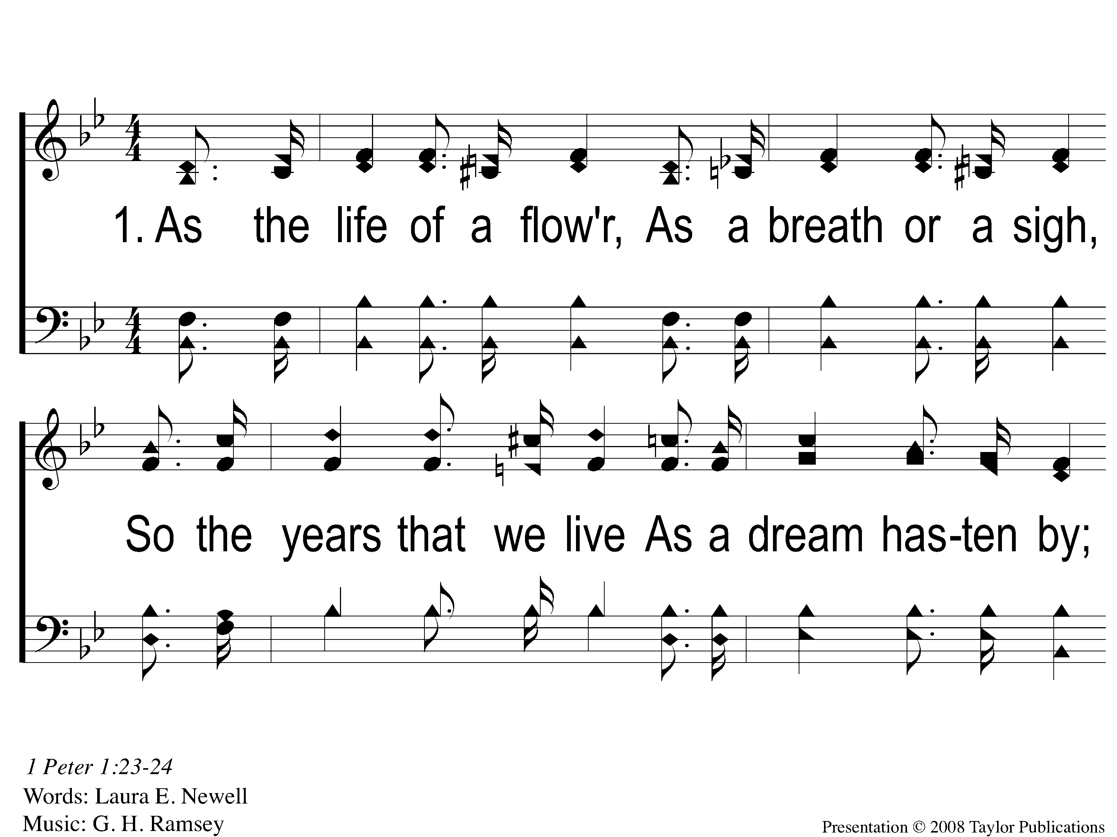
1-1 As The Life Of A Flower
As The Life Of A Flower
27

Slide 2
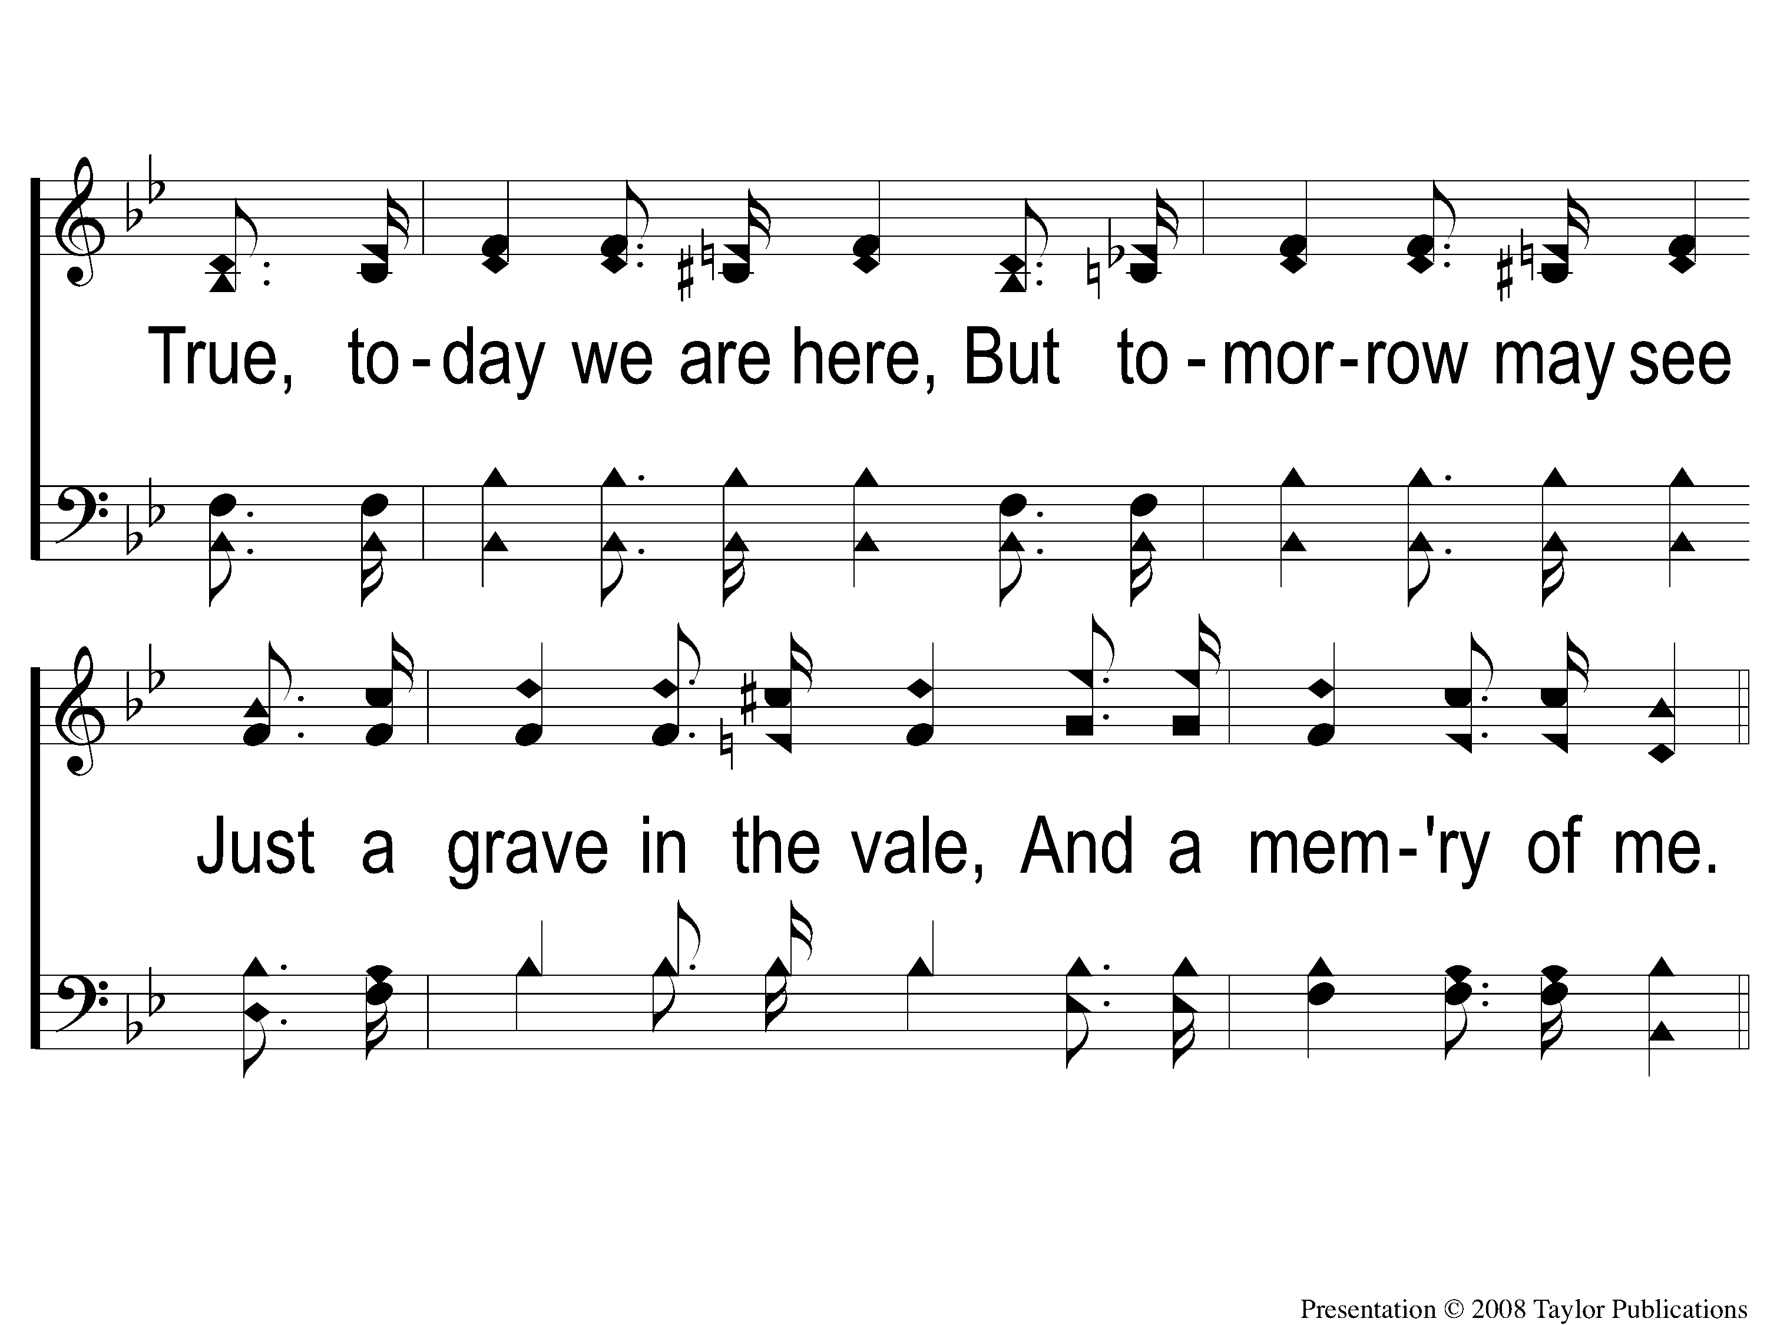
1-2 As The Life Of A Flower
As The Life Of A Flower
27

Slide 3
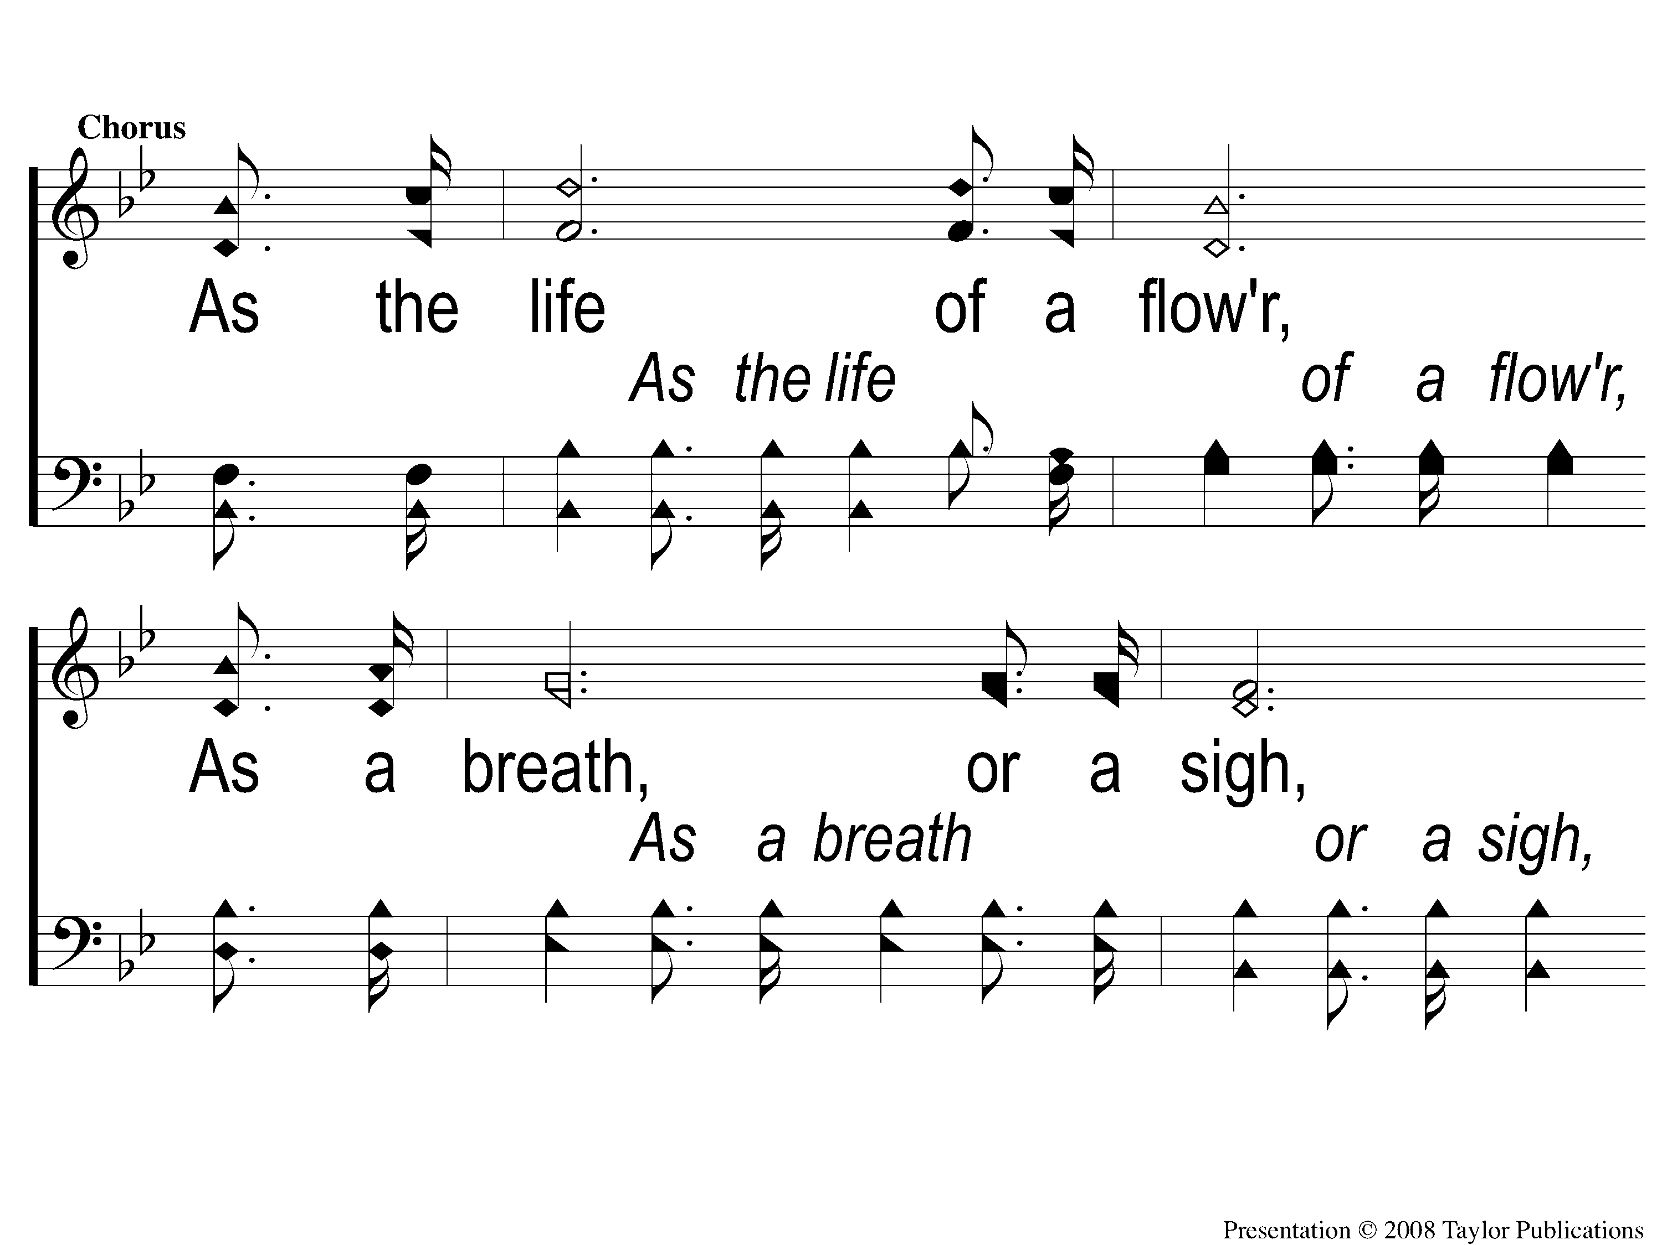
C-1 As The Life Of A Flower
As The Life Of A Flower
27

Slide 4
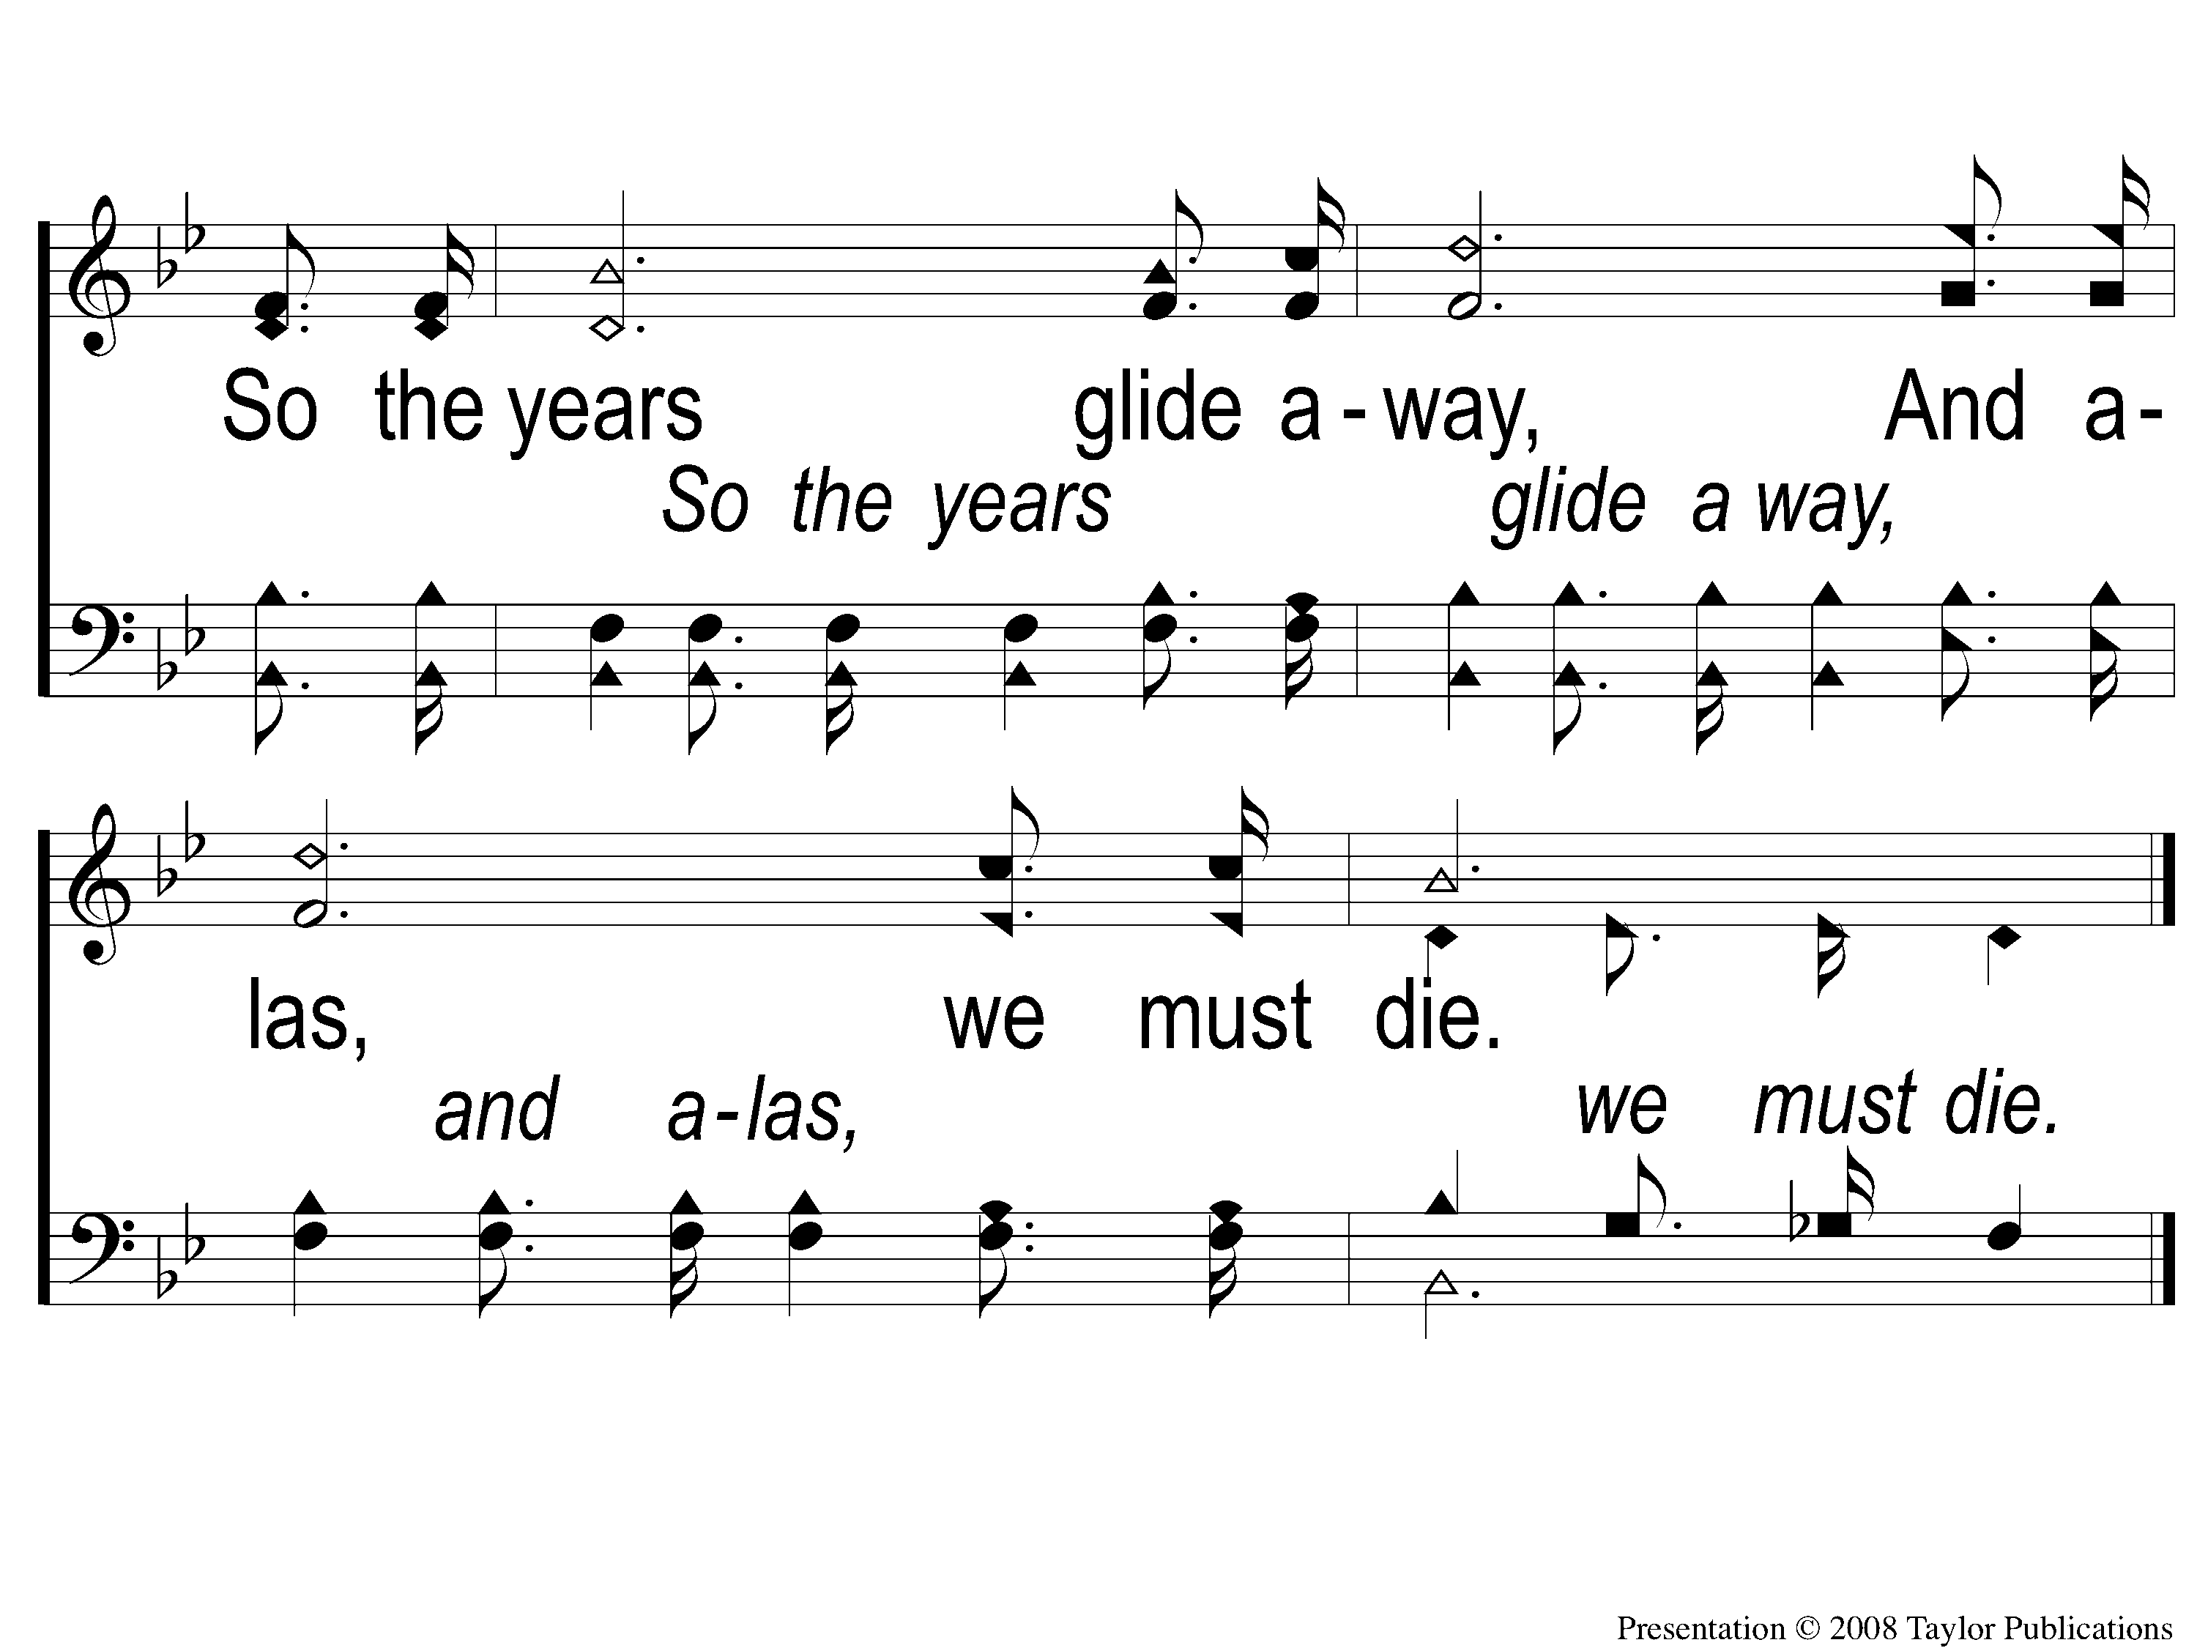
C-2 As The Life Of A Flower
As The Life Of A Flower
27

Slide 5
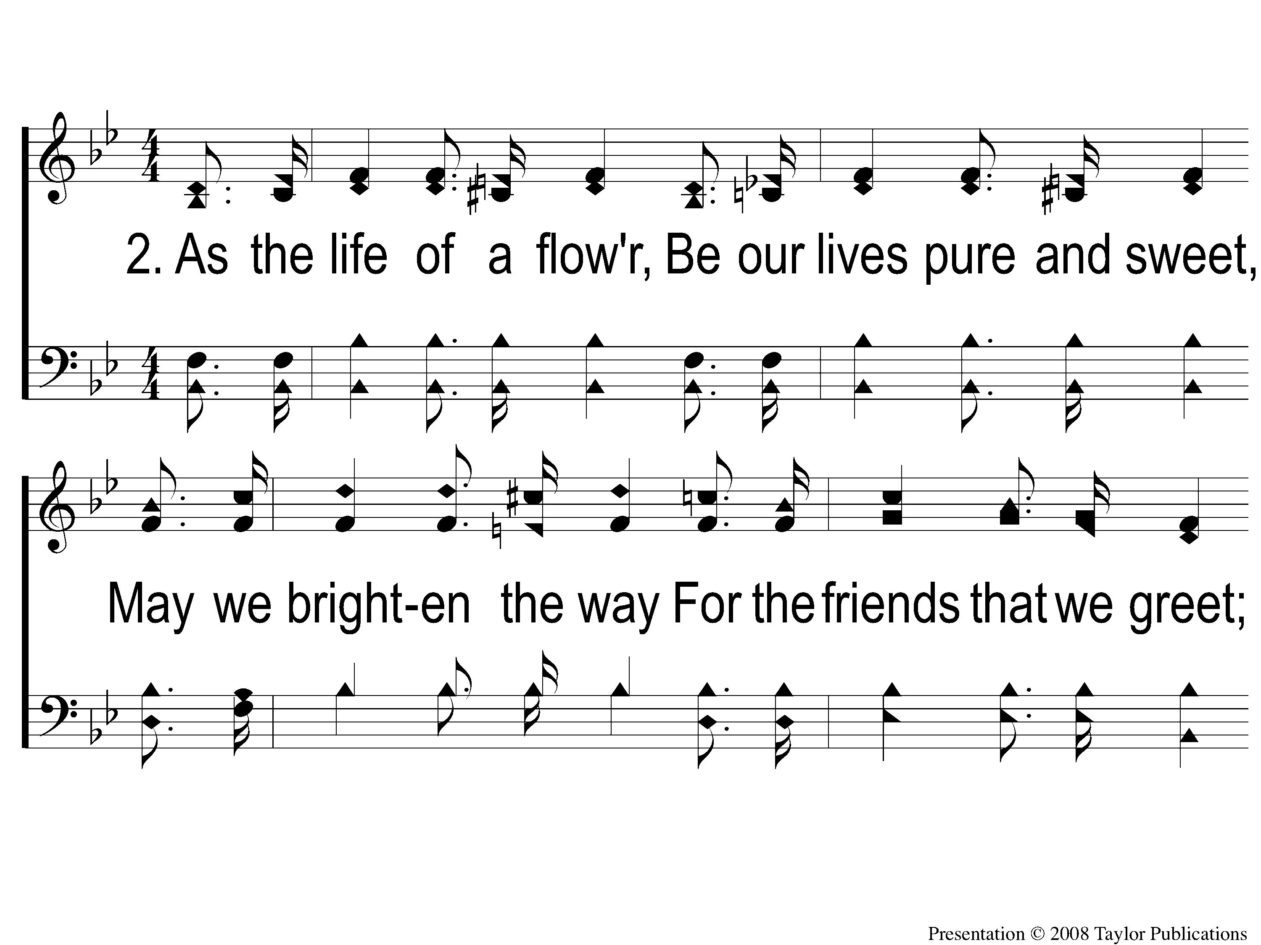
2-1 As The Life Of A Flower
As The Life Of A Flower
27

Slide 6
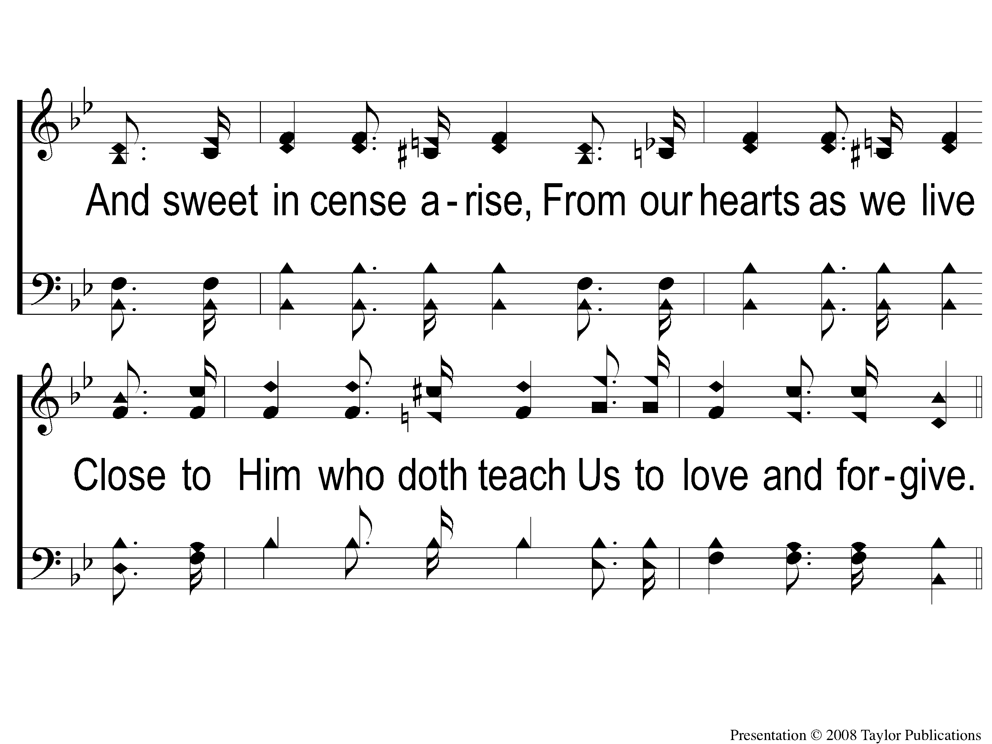
2-2 As The Life Of A Flower
As The Life Of A Flower
27

Slide 7
C-1 As The Life Of A Flower
As The Life Of A Flower
27

Slide 8
C-2 As The Life Of A Flower
As The Life Of A Flower
27

Slide 9
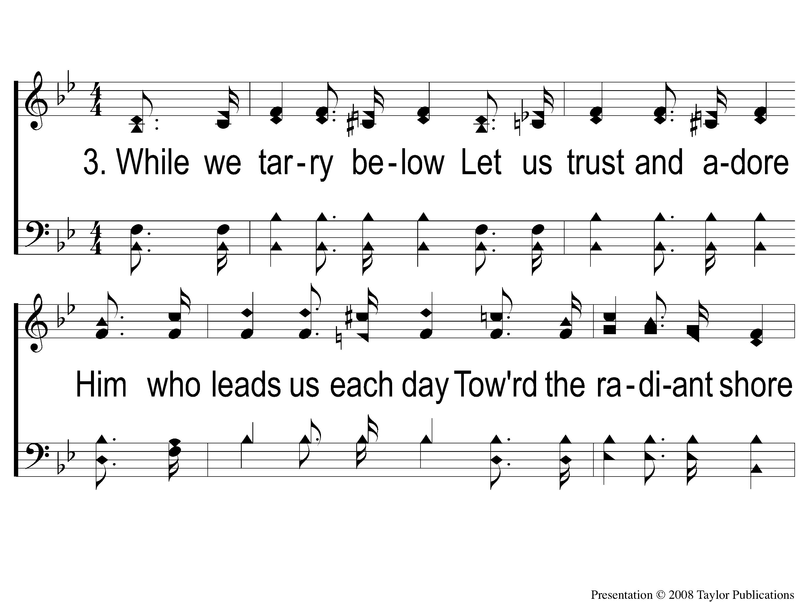
3-1 As The Life Of A Flower
As The Life Of A Flower
27

Slide 10
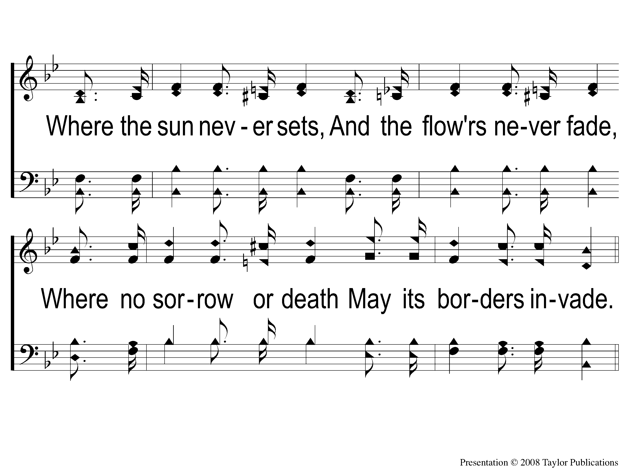
3-2 As The Life Of A Flower
As The Life Of A Flower
27

Slide 11
C-1 As The Life Of A Flower
As The Life Of A Flower
27

Slide 12
C-2 As The Life Of A Flower
As The Life Of A Flower
27

